Slide 1
PhoneGap and Xamarin: Your Excuse to Not Write Your Mobile App is Gone
Jerrel Blankenship & Jamie Dicken

Slide 2
Who We Are
Jerrel Blankenship
@TheJerrel
Jamie Dicken
@DotNetGeekette
Software developer and team lead at McKesson-RelayHealth
Mobile enthusiast
Volunteer at Per Scholas

Slide 3
The Case for Cross-Platform Development

Slide 4
PhoneGap

Slide 5
What Is PhoneGap?
PhoneGap is an open source framework for creating mobile apps using a single codebase that can deploy across the major mobile platforms.
Notes:
PhoneGap is an open source framework for creating mobile apps using a single codebase that can deploy across the major mobile platforms – iOS, Android, Windows Phone, Blackberry, and webOS.
There are multiple frameworks for creating cross-platform mobile applications, including Xamarin and app Mobi, so what makes PhoneGap different? For one, the technologies are different. Consider the major mobile platforms.

Slide 6
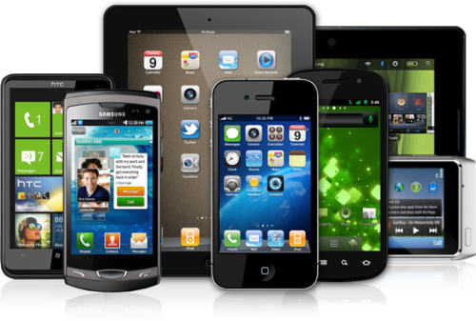
The Common Element
Notes:
While they seemingly have little in common from a programmatic standpoint in that they all use their own languages and SDKs, the one piece they all share a browser that adheres to the same standards.
PhoneGap takes advantage of this commonality and allows you to create natively installed mobile apps that basically run in a chromeless web browser. This means that you can leverage the web development skills you have and write apps for all of the major mobile platforms using HTML, Javascript, and CSS.

Slide 7
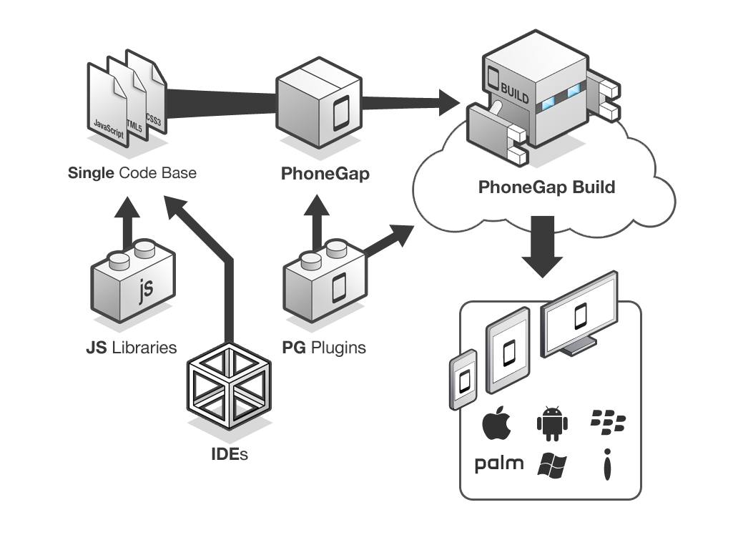
PhoneGap Overview
Notes:
Essentially, this is what the PhoneGap application creation process looks like. You take your IDE of choice as well as the javascript libraries you know and love, like jQuery mobile. You create one codebase, thereby eliminating the maintenance nightmares we face with redundant codebases. You wrap your html, css, and javascript files with PhoneGap, and you can take advantage of the PhoneGap plugins that interact with your device’s capabilities, like the camera and geolocation services. You send your app to PhoneGap build, and you end up with ready-to-submit app packages for each of the target platforms.

Slide 8
Let’s Create an App!

Slide 9
Testing a PhoneGap App
Notes:
When I’m developing for the web, for me, Chrome developer tools are second to none. So yes, while there are ways to debug Javascript in Visual Studio, I typically choose not to, and in my experiments with PhoneGap, I also chose to pursue an alternative route.
Fortunately, there’s a Chrome extension called the Ripple Emulator. The idea is that you can get a sense for how your app will look on different screen sizes, and you have the added benefit of being able to use Chrome’s Javascript debugging tools.
With the Ripple Emulator, you can view any website or any app, provided that it has been deployed to a URL your computer can reach. In Visual Studio, I can open my solution as a web site, run that locally using Chrome, and enable Ripple.
One caveat with the Ripple Emulator – it really should be used only to debug Javascript. While you’ll see your app in what looks like an iPhone 4, the emulator unapologetically doesn’t render your app the same way an iPhone would. As always, before deploying your app to an app store, you’ll want to test it on an actual device.

Slide 10
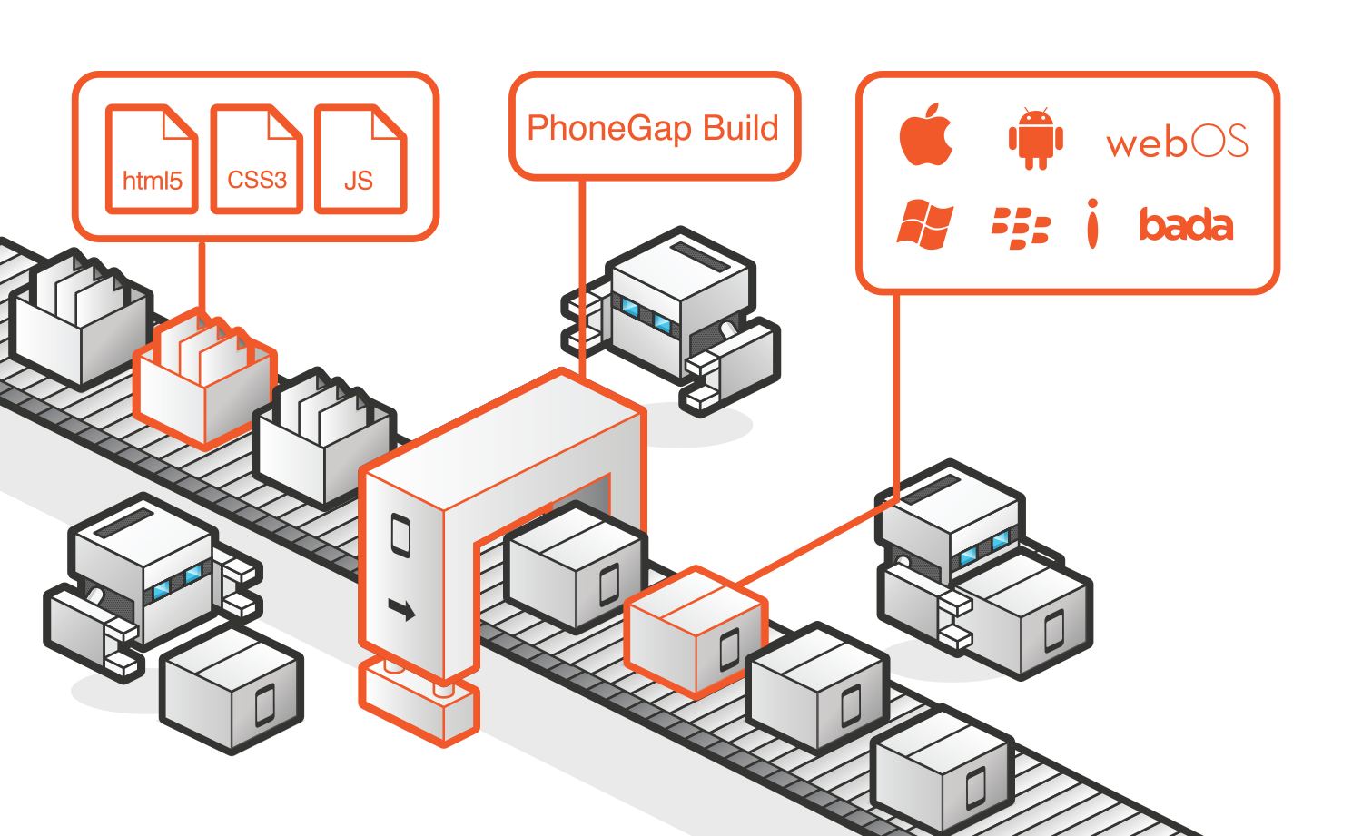
PhoneGap Build
Notes:
Once you’re ready to get started, it’s very easy to begin development on a PhoneGap app.
The prerequisite to all of this is, of course, the Windows Phone SDK and the latest copy of PhoneGap extracted to some location on your machine.
In the lib directory of the PhoneGap download is a Visual Studio template file, which you will copy into your Visual Studio project templates folder.
When you create a new project in Visual Studio, you’ll then see your Apache Cordova template, you’ll select that, and you will then be able to begin your development.
Once you’ve created your project, you’ll see three key areas of note.
First we have the www folder, which contains all of the html, javascript, and css for the app. It also contains the cordova.js file, which contains the necessary javascript to launch your app.
You’ll also see that you have the same manifest files you have when you’re developing specifically for Windows Phone. When you go to build your app for multiple platforms, the information in this manifest will be used in the packaging information for other platforms as well.
Finally, you’ll see a list of plugins. These give you the ability to do things like interact with your device’s camera or contact list, launch another web browser, set up app notifications, and do the same kinds of things you could do if you were developing for a particular mobile device. The nice thing here is that you don’t have to maintain that device-specific functionality yourself, and you can use what’s already in the box. While the files in this solution are written in C#, you’ll be writing API calls in your javascript to take advantage of this functionality on each platform.

Slide 11
Xamarin

Slide 12
PhoneGap v. Xamarin: Which do I choose?
Notes:
Jamie: Now that we’ve shown you two tools for cross-platform mobile development, the question becomes “which one should I use?”
Jerrel: Clearly, both of these tools allow you to easily create an app to deploy to all of the major app stores, so it really comes down to what you’re trying to accomplish.
Jamie: Let’s take a look at the advantages and disadvantages of each.

Slide 13
PhoneGap
Advantages
Cost
Speed to Market
Disadvantages
Performance
Lacks the look-and-feel of a native app
Notes:
As for PhoneGap…
Cost
You don’t have to spend ramp-up time learning the languages and the toolsets for development in each of the major mobile platforms. Development is in HTML, CSS, and Javascript – for every platform. This is truly your develop-once, deploy everywhere solution.
Additionally, the toolset is completely free.
By far, this is easily your cheapest solution.
Speed to Market
If you have a new idea that you want to test out, you can get it out there very quickly, and you don’t have to choose which platform to target. If you just want to get something out the door so you can get feedback on it before you begin to invest the time and money into another cross-platform mobile app development framework, then PhoneGap can certainly be that kind of stop gap solution for you.
Performance
Easily, this is one of the biggest criticisms of PhoneGap. Oftentimes, the tools we use to make development easier, like jQuery and jQuery mobile, actually hamper performance since they weren’t built to target PhoneGap. There are groups of PhoneGap developers out there who are building similar libraries to improve the performance of these apps, but even with those, PhoneGap apps are simply slower than native ones, so they don’t make for a great user experience when realtime data is a must.
Perhaps the key indicator of the performance disadvantage is that there’s a splash screen on the app that I demoed. In mobile platforms, like Windows Phone 8, they got rid of the splash screen because it simply wasn’t needed.
Lacks the Look-and-Feel of Native Apps
As you can tell by the app I demoed, it looks like a webpage and not a mobile app. Surely, I could have used different controls, selected a different layout, etc., but in the end, it looks like a webpage.
If I would develop an app specifically for iOS, like if I didn’t want to learn Objective C or even buy a Mac, I could specifically style it to look like an iOS app. The disadvantage would be that it would also look like an iOS app if I were to download and run this app on an Android, Windows Phone, or Blackberry.
There is one alternative, but it’s a little hacky. Let’s take a look (show).
PhoneGap provides the ability to access the platform where the app is running. As such, you have the ability to load your CSS conditionally based on the platform.
In the index.js file provided in the PhoneGap template, there’s a device.ready() function. It’s very similar to the document.ready() function you’d use on a webpage. That’s the first chance when you have access to device.platform.
As I said, it’s not the cleanest solution, and it certainly doesn’t help your performance if you’re conditionally loading CSS after the DOM is loaded. However, if you don’t have all that much CSS, you likely won’t notice any lag or any painting issues, so it is technically possible to overcome this hurdle.

Slide 14
Xamarin
Advantages
Disadvantages

Slide 15
Questions?
Notes:
Jamie: Well, there you have it – two very different tools for creating cross-platform mobile applications. One leverages your web skills of HTML, CSS, and Javascript. The other allows you a cleaner way to have a different user interface per platform, easily making your apps seem much more targeted per environment and therefore enhancing the user experience.
Jerrel: And with that, your excuse to not write your mobile app is gone!

Slide 16
Image Attributions
Diagram - PhoneGap Overview by Adobe / Yohei Shimomae
Diagram - PhoneGap Build by Adobe / Yohei Shimomae
Smart Phone, Tablet, and PC – The Droid Guy

